Slide 1






w e l c o m e
Denver Dev Day - June 23, 2017
"Donations by YOU, Denver Dev Day attendees,
are provided to support KidsTek, http://kidstek.org - Thank you!"

Slide 2
Better Business Logic with Typescript
Implementing and Using Design Patterns with Angular

Slide 3
Contact Information
Matt Vaughn
E: matt.vaughn@buildmotion.com
W: www.buildmotion.com
GitHub: https://github.com/buildmotion
Code Samples and Presentation
GitHub: https://github.com/buildmotion/better-business-logic-with-typescript

Slide 4
Objective
The session will show you how to use and implement design patterns (like Composite, Builder, Template Method and others) using Typescript. The session will demonstrate code reuse strategies and extensibility techniques for building robust Angular Services and Business Logic.
The session will demonstrate how to implement shared Angular services and how to use them in Angular domain services. The services will include rich business logic layers that use the angular-rules-engine and angular-actions NPM packages.
Copyright © 2017 Build Motion, LLC. All rights reserved.

Slide 5
Business Logic

Slide 6
Business Logic – Why important?
Heart of the application.
Defines the business domain.
Domain specific algorithms, intellectual property, etc.

Slide 7
Business Logic – Why Difficult?
Inconsistent implementation causes problems with extensibility/maintainability.
Architecture, design, or implementation makes it difficult to test.
Different implementation styles by different developers create inconsistent code base.
Single Responsibility Principle not followed - parts of code do too much.
Separation of Concerns Principle not followed - parts of the code cross boundaries. BL contained in different layers of the application (UI, services, BL layer, database).
Lack of structure or use of defined patterns.

Slide 8
Angular Modules

Slide 9
What is an Angular Module?
What is a module…?
A container of related elements.
A module may have: components, directives, pipes, or services.
Angular application can only one root module: AppModule.
Angular application can have zero-to-many feature modules.
Core
Shared
Feature

Slide 11
Are there any limits…really?
How many modules can you Angular application have?
Must a module have a service?
Must a module have components?
Are there different kinds of modules?
What kind of modules does my application need?

Slide 12
Consider Module…Categories/Types
Shared
Angular: NgModule, CommonModule, HttpModule, FormsModule, etc.
Third-Party Modules: Wijmo, Material Design
Core: Application-Level Modules
Modules: PagesModule, LayoutModule
Services: LoggingService
Components: MenuComponent, FooterComponent
Infrastructure: Base/Foundation
Base and Framework (i..e, buildmotion-foundation, angular-actions, angular-rules-engine)
Domain Service: Service-Only
Module: SecurityModule
Service: SecurityService
Components: none
Domain UI: UI-Only
Module: SecurityUIModule
RoutingModule: SecurityRoutingModule
Components: LoginComponent, SignUpComponent. ResetPassword, ForgotPassword

Slide 15
Design Patterns
A brief introduction

Slide 16
What is a pattern?
Is a general reusable solution to a commonly occurring problem within a given context in software design.
Design patterns can speed up the development process by providing tested, proven development paradigms.
Improves code readability for coders and architects who are familiar with the patterns.
Many patterns based on Object Oriented Programming techniques: inheritance, abstraction, encapsulation, and polymorphism.
Many patterns support and promote:
Single Responsibility
Separation of Concerns
S.O.L.I.D Principles

Slide 17
Why Use Design Patterns?
What does this do for me or my team?
Creates a consistent code base for improved maintainability.
Inherently allows for more extensibility points.
Promotes a more testable solution (unit and integration tests) with mocks and fakes. Better quality.
Allows dependency injection opportunities.
What problems to they solve?
Help with refactoring code to improve testability, extensibility, and maintainability.
Many patterns allow for additional extensibility points.
Use existing patterns without creating atypical solutions for common problems.
The team has a recipe for implementing parts of the application.

Slide 18
Patterns are Everywhere!
Many examples of patterns in real life.
Software and Frameworks
.NET
ASP.NET
ASP.NET MVC
Angular
Typescript…

Slide 19
“I see Angular Patterns…”
Template Method
Lifecycle Hooks: ngOnChanges, ngOnInit, ngDoCheck, and ngOnDestroy
Composite
A component can reference a component that has a component that has a component.
Mediator
A parent-component or injected service can mediate communication between loosely-coupled components/child-components.
Observer
A component can subscribe to and react to an Observable response.
Facades
Services provide end-points to perform some action. How the action is performed is not known by the calling component.
Dependency Injection (Inversion of Control – IoC)
Services are instantiated and injected into components.

Slide 20
“Use the Angular…Luke.”
Use the elements in the Angular Framework
Modules
Services
Components
Dependency Injection
Code Smell: var thingService = new ThingService(..);
Use the “force” – Use the “angular”.
If there is a way to do it in Angular, learn and use that mechanism.

Slide 21
Façade Pattern

Slide 22
Façade Pattern Details
Definition: A single class that represents an entire subsystem.
Useful in API design
Useful in Service Oriented Architectures (SOA)
Typically implements an Interface.
Typically does not provide an implementation – but, delegates to a lower-level business layer.
An Angular Service can be a Façade.

Slide 23
Template Method Pattern
There is a method to this madness.

Slide 24
Business Logic Madness
Business Logic
Data Input Validation
Business Rule Implementation
Authorization or Permissions?
Retrieving and persisting data
Handling exceptions.
Handling error responses from the backend.
Notifications to Users

Slide 25
Business logic goals?
Goals:
Consistent
Maintainable
Testable
Extensible
High Quality
How can we achieve this?

Slide 26
Elevate Your Business Logic
Stop the Method Madness
Use classes to implement your business logic.
A single class with a single responsibility, a single unit of work.
This is not the typical Manager class with a bunch of methods chained together.
Class Advantage
Can use one or more Constructors.
Can have base classes - Inheritance.
Can implement an Interface.
Can expose typed Properties.
Can encapsulate members using private.
Design Patterns
Template Method (Lifecycle/Pipeline)
100% Testable

Slide 27
Template Method Pattern
Where have you seen this one?
ASP.NET Forms circa 2001: PreInit, Init, InitComplete, PreLoad, Load, LoadComplete, PreRender, etc.
Angular 2: ngOnChanges, ngOnit, ngDoCheck, ngOnDestroy
If it is good enough for managing components and web forms with millions of different implementations – but, all using the same algorithm.

Slide 28
Template Method Pattern :: Details
Definition: defines an algorithm (i.e., pipeline of methods and/or events) that can be implemented with concrete classes without changing the structure of the algorithm.
Creates a consistent well-defined flow – that also enables default or shared behaviors to be implemented for all implementing classes.
Allows for customized implementations of pipeline items within the algorithm.
Allows for extensibility end points without disturbing the structure of the algorithm.
Simplifies the target concrete implementation by allowing other non-essential details to be handled by the base/abstract classes that define and implement the template algorithm.
Example: GitHub

Slide 30
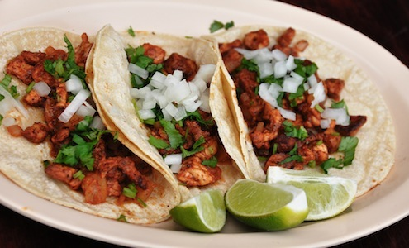
DEMO :: Taco Template

Slide 31
DEMO
http://dev.hybridmobileapp.net

Slide 32
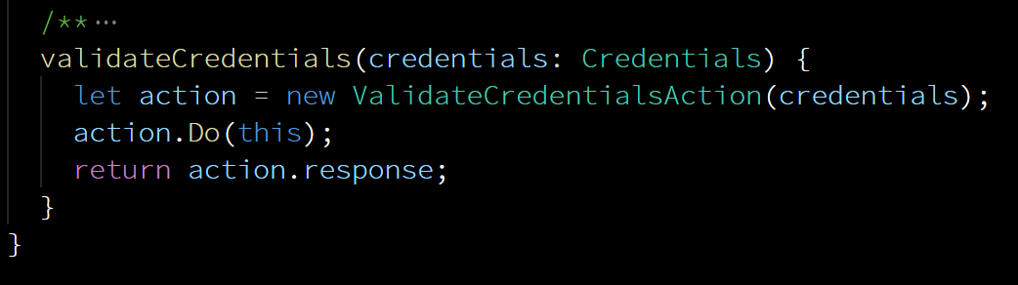

Slide 33
Action Pipeline
Service delegates to the Business Layer to process request.
The Business Layer initializes a new Action and Executes action.
The concrete action implements the preValidationAction() method and the performAction() method.

Slide 34
Template Method Recap
You can define the algorithm/recipe for your business logic processing.
Logging
Auditing
Authorization
Validation and Business Rule processing
Consistent and Reliable
Provides extensibility and customization opportunities.
Uses Object Oriented Programming
Scaffold with Templates

Slide 35
Composite Pattern

Slide 36
Composite Pattern
Where have you seen this one?
File Explorer
Angular 2 Components

Slide 38
Demo(s)
Angular Sample Application
Rules
Simple (Primitive)
Complex (Composite)
Account Signup

Slide 39
Composite Pattern Recap
Simple to implement.
Create simple/complex items in a hierarchy or tree-like view.
Process/Handle either (simple/composite) types consistently.

Slide 40
Conclusions

Slide 41
Final thoughts…
Business Logic is very important – yet challenging.
Needs to be protected as a valuable resource.
Patterns and Frameworks help control the chaos.
Understand and use the elements that Angular provides more fully.
Higher Quality Systems
Testable
Extensible
Maintainable
Take time to learn and understand different design patterns.

Slide 42
Web References
GoF Design patterns in .NET/C#
Design Patterns General
Creational
Structural
Behavioral
Principles:
Single Responsibility
Separation of Concerns
S.O.L.I.D Principles

Slide 43
Book References
Design Patterns : Elements of Reusable Object-Oriented Software
ISBN-13: 978-0201633610, ISBN-10: 0201633612
Head First Design Patterns
ISBN-13: 978-0596007126, ISBN-10: 0596007124
Clean Code
ISBN-13: 978-0132350884, ISBN-10: 0132350882
The Pragmatic Programmer
ISBN-13: 978-0201616224, ISBN-10: 020161622X
Patterns of Enterprise Application Architecture
ISBN-13: 978-0321127426, ISBN-10: 0321127420

Slide 44
Angular Resources
https://angular.io:
https://rangle.io:
Rangle’s Angular 2 Training Book
Functional Forms
Become a Ninja with Angular: sample chapters
Tour of Heroes Application with Multiple Modules

Slide 45
Miscellaneous
“Good programmers write good code. Great programmers steal.” - Unknown
Learn, Use, Copy, Borrow, and/or Steal.

